Slide 1
Chinook Database Analysis: Insights and Predictions(Data science capstone project
By
Nwadike Ijeoma Mary
aijayij@gmail.com@gmail.com
Date: 27-06-2025
Tool Stack: SQL, Python, Power BI

Slide 2
Outline:
Introduction/Data Overview
Business Analysis
Predictive Model
Insights & Recommendations
Conclusion

Slide 3
Introduction/Data overview
About the Chinook Database:
The Chinook database simulates a digital music store environment. It contains detailed records of music tracks, albums, genres, customers, invoices, employees, and purchase transactions which represents real-world business operations of a media retailer.
Purpose of the Analysis:
To uncover actionable business insights and customer behavior patterns that drive revenue.
Additionally, to develop a predictive model capable of estimating Customer Lifetime Value (CLV), empowering the business to target high-value customers, optimize marketing strategies, and support data-driven decision-making.
.

Slide 4
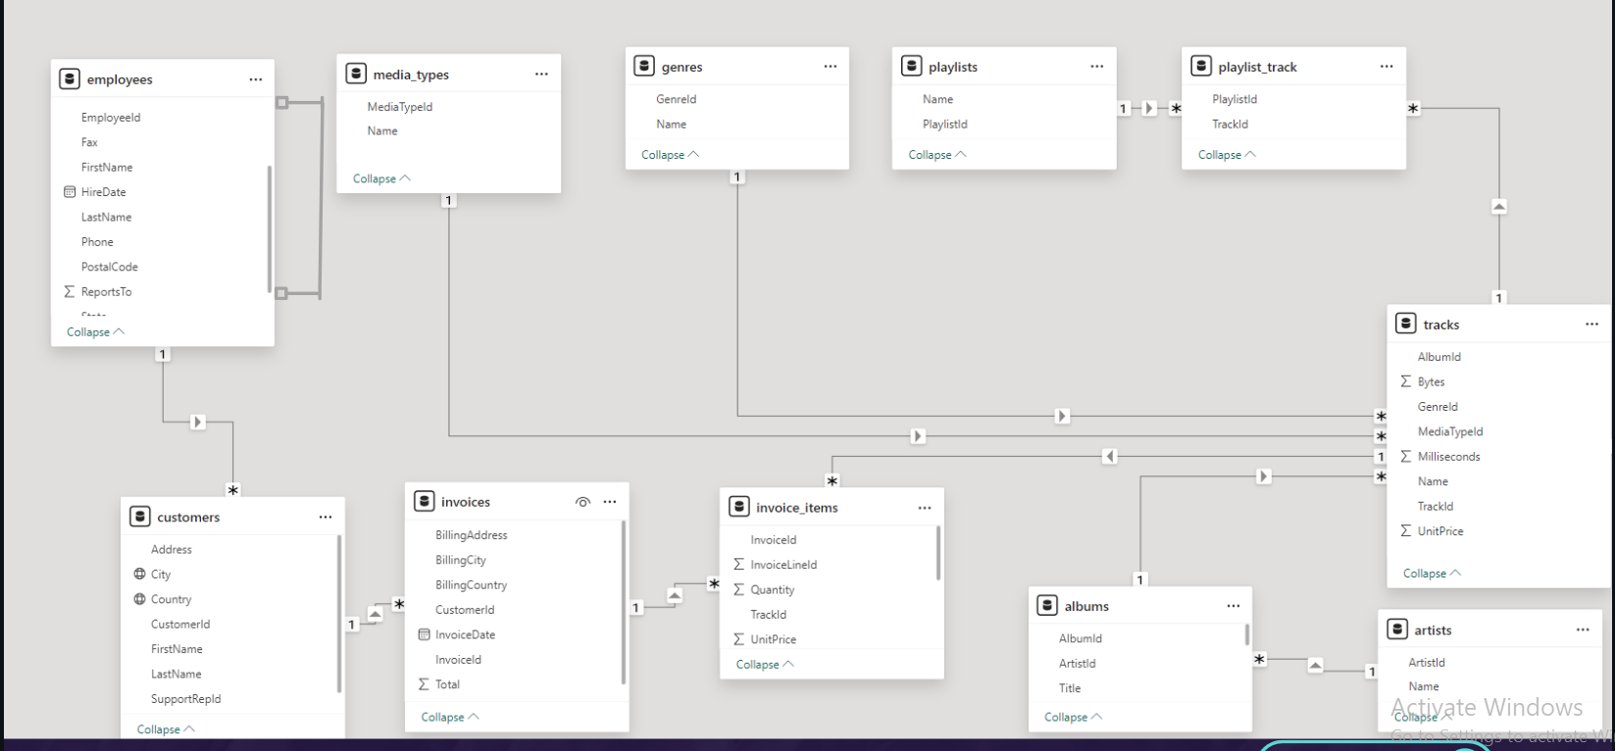
Data model

Slide 5
Tools Used
Jupyter Notebook
SQL,
Python,
Power BI

Slide 6
Key business questions
Who are the top-selling artists and how do their sales vary over time?
What customer segments exist based on purchase behavior?
Which genres are most popular and sales trend over time?
Which albums are purchased together(Market basket analysis)
How can we predict customer lifetime value?

Slide 7
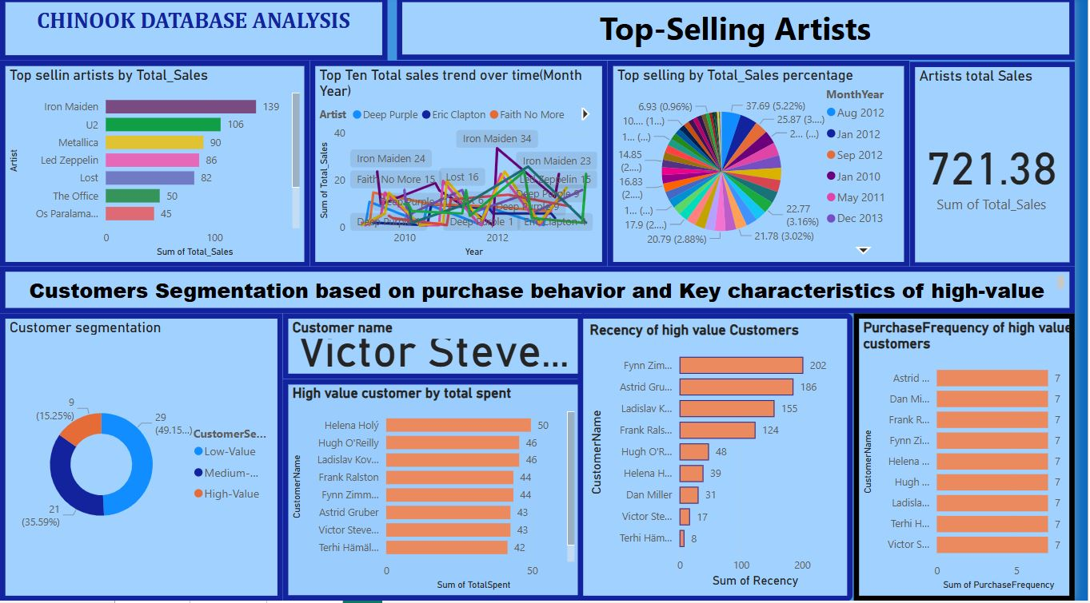

Slide 8
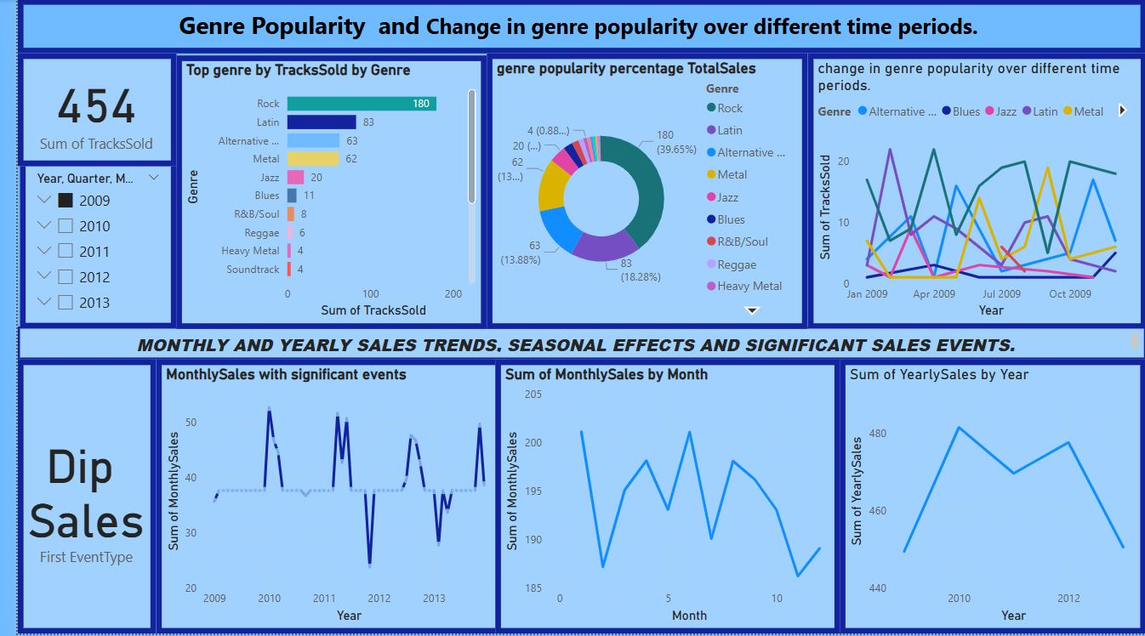

Slide 9
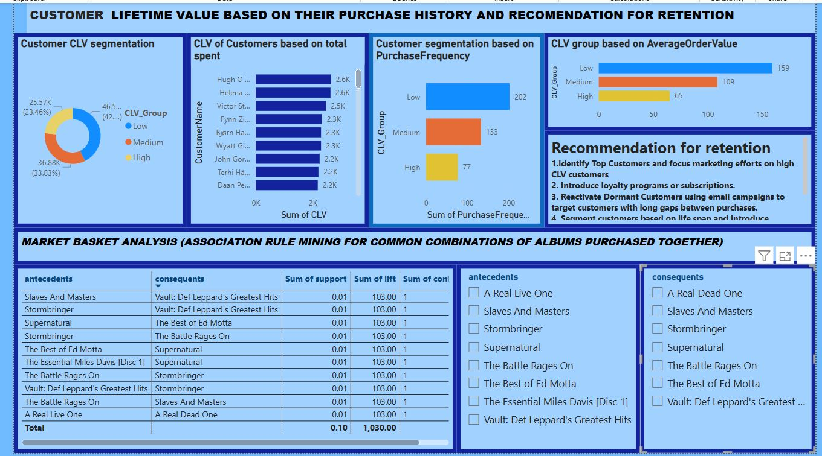

Slide 10
PART 2: Predicting Customer Lifetime Value (CLV) in the Chinook Database
Objective: To build a machine learning model that predicts Customer Lifetime Value (CLV) based on historical sales, customer demographics, and transaction patterns.
CLV Modeling Workflow
1. Data Understanding and Exploration
2. Feature Engineering
3. Preprocessing
4. Model Building & Evaluation
5. Feature Importance & Final Decision
6. Final Model Selected: Linear Regression

Slide 11
Model Result
Performance Results: Linear regression outperformed others with [Model Metric, e.g., R² =0.31], the only positive R² among the three models, indicating strong predictive accuracy for CLV.

Slide 12
Conclusion: Strategic Insights & Business Impact
Comprehensive analysis of the Chinook database reveals key patterns in customer behavior, sales dynamics, and growth opportunities.
The Rock genre dominates sales, and high value customers contribute significantly to overall revenue, emphasizing their strategic importance.
Seasonal fluctuations suggest timing promotions for peak effectiveness.
Top-performing artists and frequently paired albums present strong opportunities for cross-selling and bundling.
Implementing targeted marketing, data-driven promotions, and CLV-based segmentation can enhance loyalty and revenue consistency.
Modeling Outcome: Linear regression delivers the most reliable CLV predictions (R² = 0.31), outperforming more complex models.

Slide 13
Recommendations
Prioritize High-Value Customers: Identify and retain high value customers through personalized loyalty programs and exclusive incentives.
Genre-Focused Marketing: Maximize engagement and revenue by emphasizing high-performing genres such as Rock, Latin, and Metal in promotional strategies.
Stabilize Seasonal Sales: Mitigate off-peak periods (e.g., November, December, February) with timely campaigns, discounts, and special events to maintain consistent revenue flow.
Strengthen Artist Collaborations: Foster partnerships with top-selling artists (e.g., Iron Maiden, U2) to drive recurring sales and reinforce brand positioning.
Boost Cross-Selling Opportunities: Apply market basket analysis insights to develop bundled offerings and personalized recommendations, increasing average order value and customer satisfaction.

Slide 14
Thank You
Contact: aijayij@gmail.com

